Slide 1
Detecting Pneumonia In X-Ray Images Using Deep Learning

Slide 2
Pneumonia in the US
About 1 million adults seek care in a hospital per year
50,000 deaths per year
Half of all pneumonia hospitalizations are younger adults(18-57 years old)

Slide 3
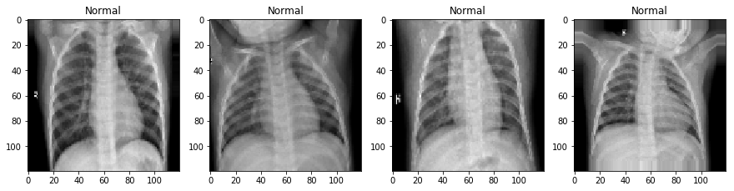
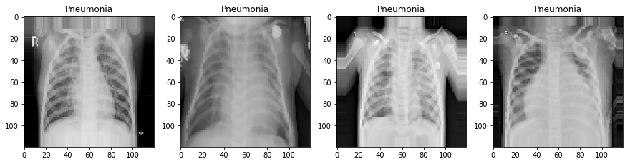
Pneumonia

Slide 4
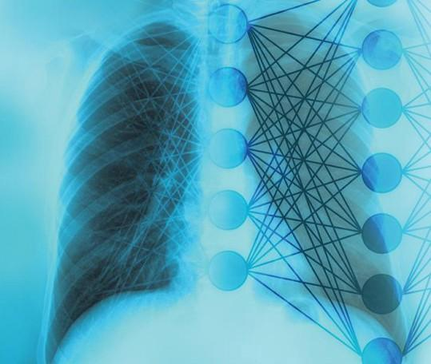
93.4%
Best Model
Accuracy

Slide 5
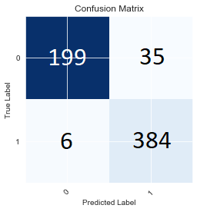
98%
85%
Recall
Specificity

Slide 6
Future Work
More data could be used to further improve upon the model
The model has only been tested on one set of data, extra testing data could help to confirm the models performance
More time could be spent tuning the model to increase specificity

Slide 7
Thank you

